Slide 1

ZeroHate: AI-Powered Content Moderation with Zero Trust Security
Presented By:
Muhammad Toseef Haider 2022-CS-16
Arsal Noor 2022-CS-47

Slide 2
Project Overview & Challenge
Problem Statement
Our Solution
Online platforms face rising toxic content threats.
Built AI-powered web app detecting harmful text.
This impacts user safety and overall experience.
Enabled secure, fast, and reliable content moderation.

Slide 3
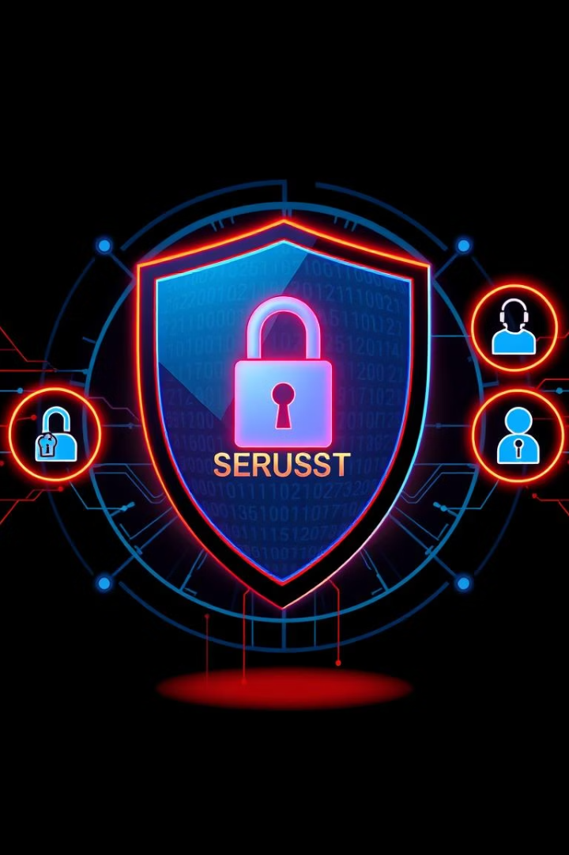
Zero Trust Security Explained
Strict Verification
Least Privilege Access
No user is trusted without verification.
Access granted only as needed.
Continuous Monitoring
Ongoing checks prevent unauthorized access.

Slide 4
Tech Stack Overview
Frontend
Backend & AI
HTML
Django framework
CSS
DistilBERT for toxicity detection
JavaScript
Email & OTP for authentication

Slide 5
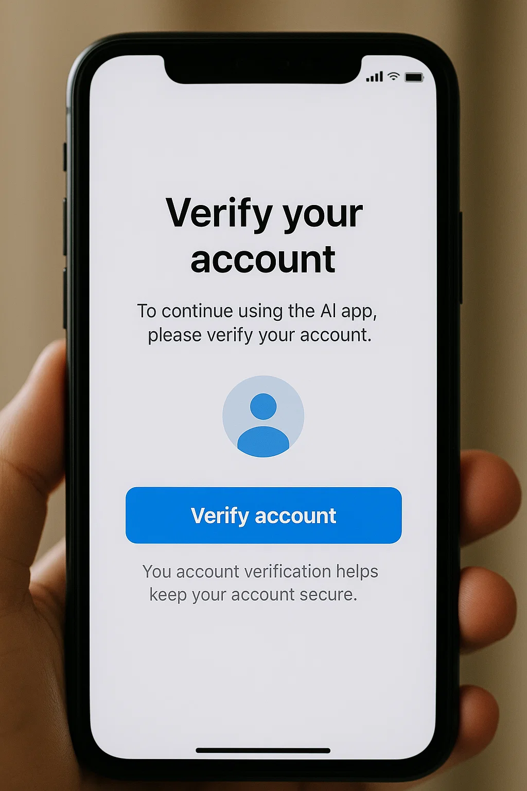



Secure Email Verification
Signup
Users receive an email with a tokenized link.
Token Expiry
Token expires in 2 minutes to prevent misuse.
Dashboard Access
Email verified before granting access.

Slide 6
OTP-Based Login Security
OTP Generation
1
6-digit code sent via email at login.
Token Validity
2
Valid only for 2 minutes to ensure security.
Two-Step Verification
3
Adds strong authentication layer to login.

Slide 7
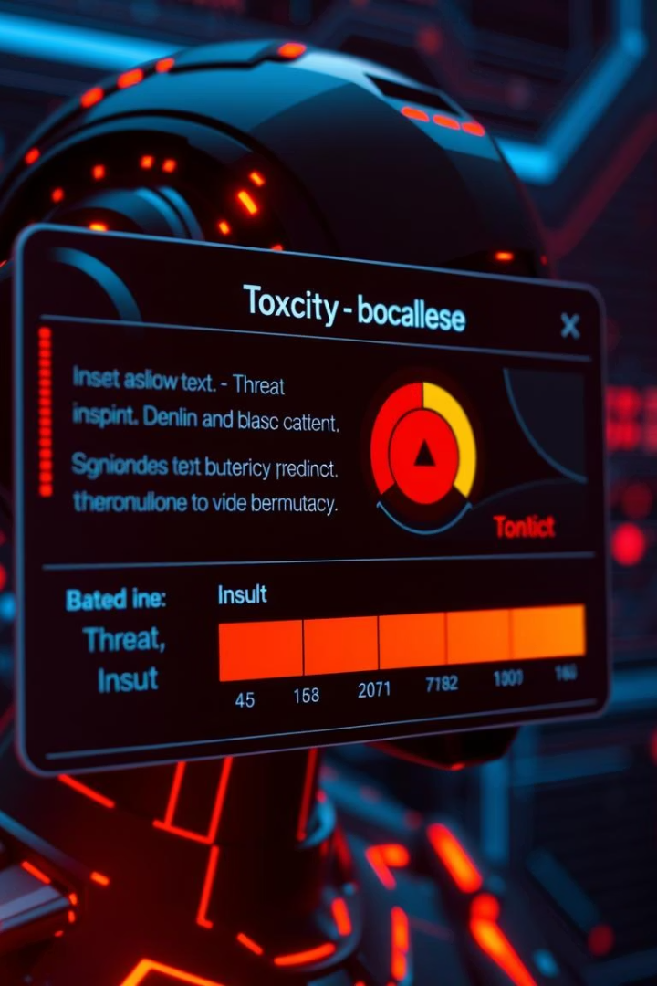
AI Toxicity Detection Process
User Input
Any text can be submitted for analysis.
Processing
Text cleaned and tokenized before AI model.
Model Output
Toxic
Threat
Insult
Storage
Securely saved results with user identifiers.

Slide 8




Robust Security Measures
User Verification
Token Handling
1
AI and login accessible only to verified users.
Expired OTPs and tokens deleted immediately.
2
Password Security
4
Data Encryption
Django hashes passwords with PBKDF2 securely.
3
Classified texts encrypted with Fernet before storage.

Slide 9
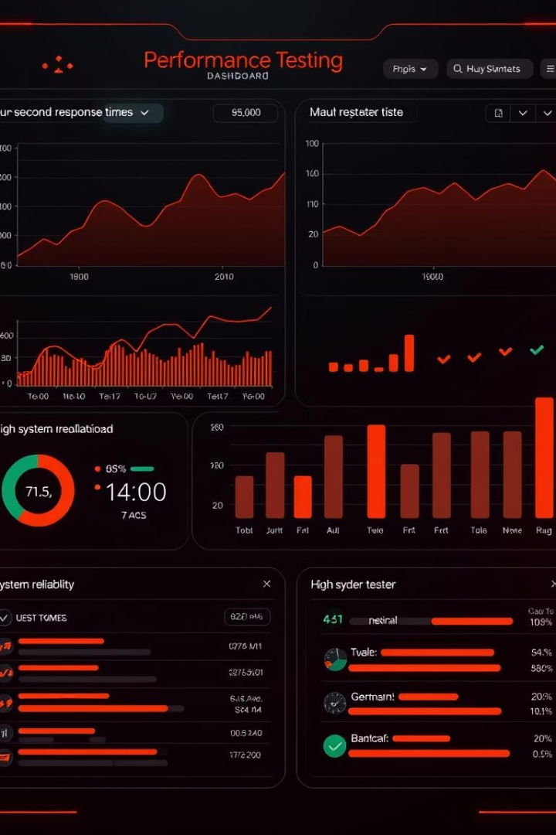
Performance & Reliability
300ms
100%
Classification Speed
Security Flows
Each AI analysis completes under 300 milliseconds.
All email, token, and OTP systems tested reliably.
Secure
Data Integrity
Results stored with timestamps and user IDs securely.

Slide 10

Conclusion & Future Work
Implemented Zero Trust for authentication and AI access.
Planned features: admin/user roles and notifications.
Future focus: adversarial input defense and ZTNA integration.

